Slide 1

Welcome to TensorFlow!
CS 20: TensorFlow for Deep Learning Research
Lecture 1
1/12/2018
Thanks Danijar Hafner for the logo!

Slide 3
Agenda
Welcome
Overview of TensorFlow
Graphs and Sessions

Slide 4
What’s TensorFlow™?
“Open source software library for numerical computation using data flow graphs”
Notes:
TensorFlow was originally created by Google as an internal machine learning tool, but an implementation of it was open sourced under the Apache 2.0 License in November 2015. Notice that we say an implementation and not TensorFlow was open sourced. Google still maintains its own internal implementation of it. For the rest of this course, when we say TensorFlow, we are referring to the open source implementation.

Slide 5
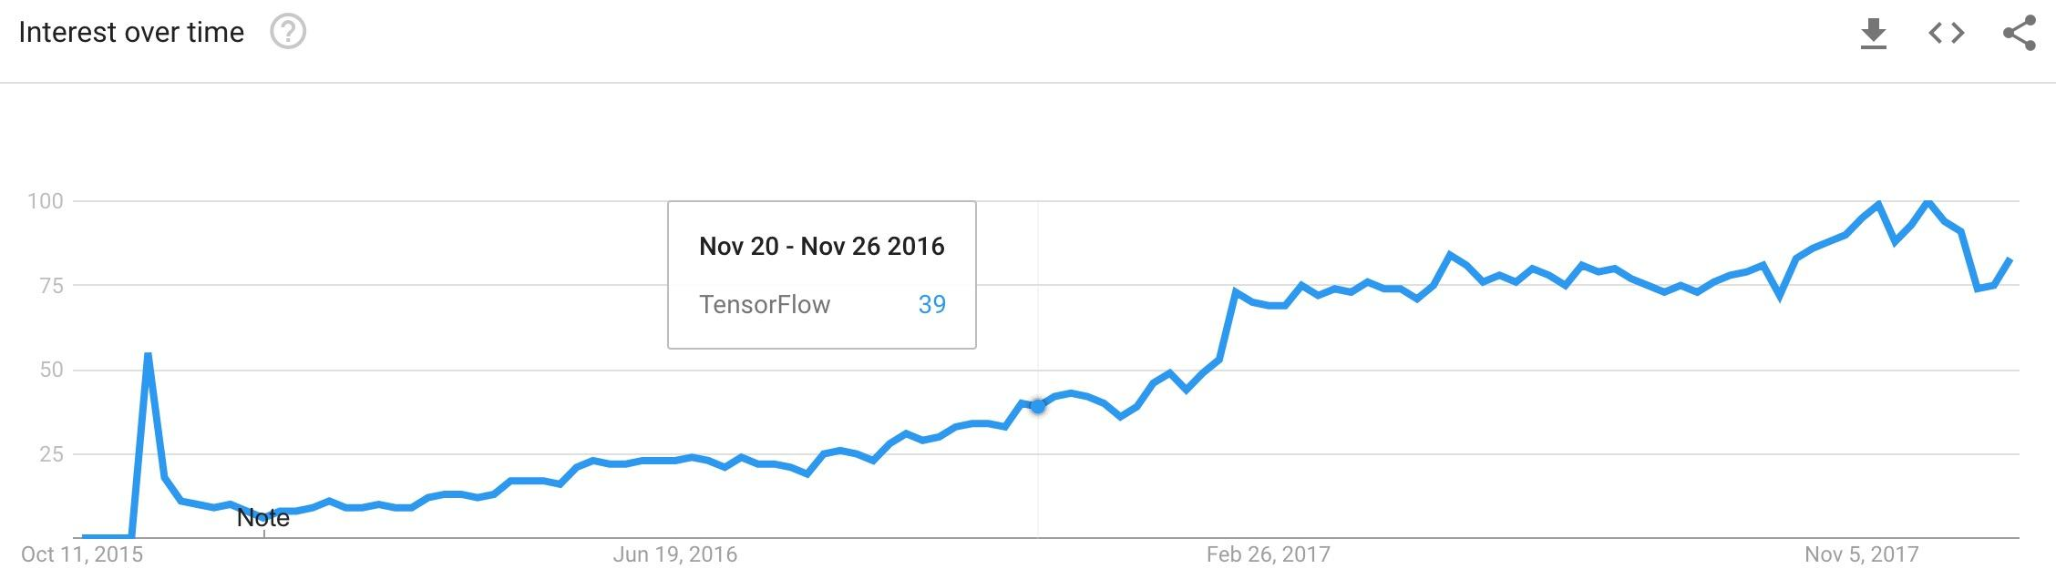
Launched Nov 2015

Slide 6
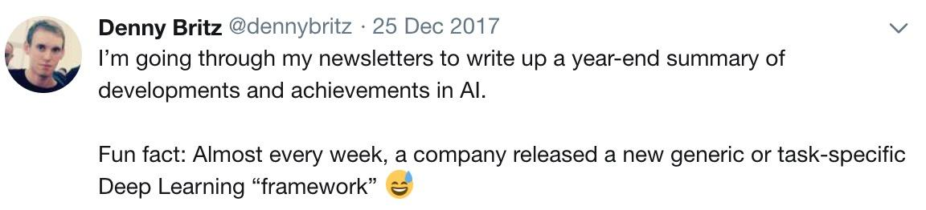
Why TensorFlow?
Many machine learning libraries

Slide 7
Why TensorFlow?
Flexibility + Scalability Originally developed by Google as a single infrastructure for machine learning in both production and research
Notes:
For a framework to be useful in production, it needs to be efficient, scalable, and maintainable. For research, the framework needs to have flexible operations that can be combined in novel ways. Alternative frameworks are either flexible enough for research but less scalable, such as Chainer and PyTorch, or scalable but less flexible, such as Caffe and MXNet. TensorFlow are both flexible and scalable, allowing users to streamline from research into production.

Slide 8
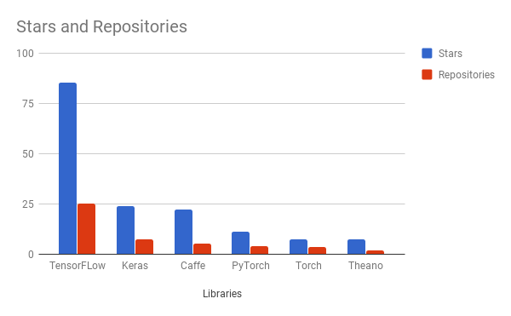
Why TensorFlow?
Flexibility + Scalability
Popularity

Slide 9
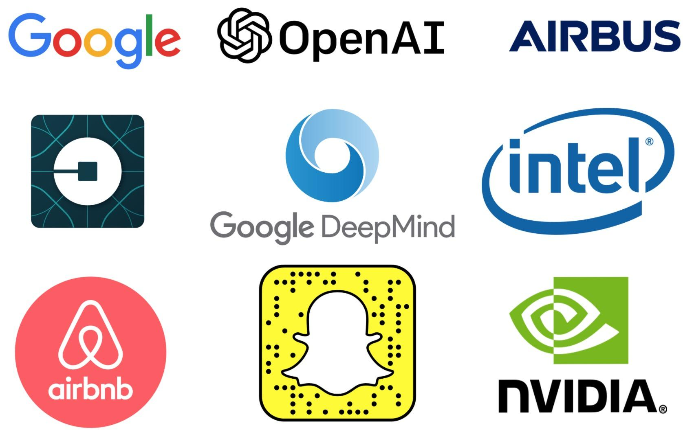
Companies using TensorFlow

Slide 10
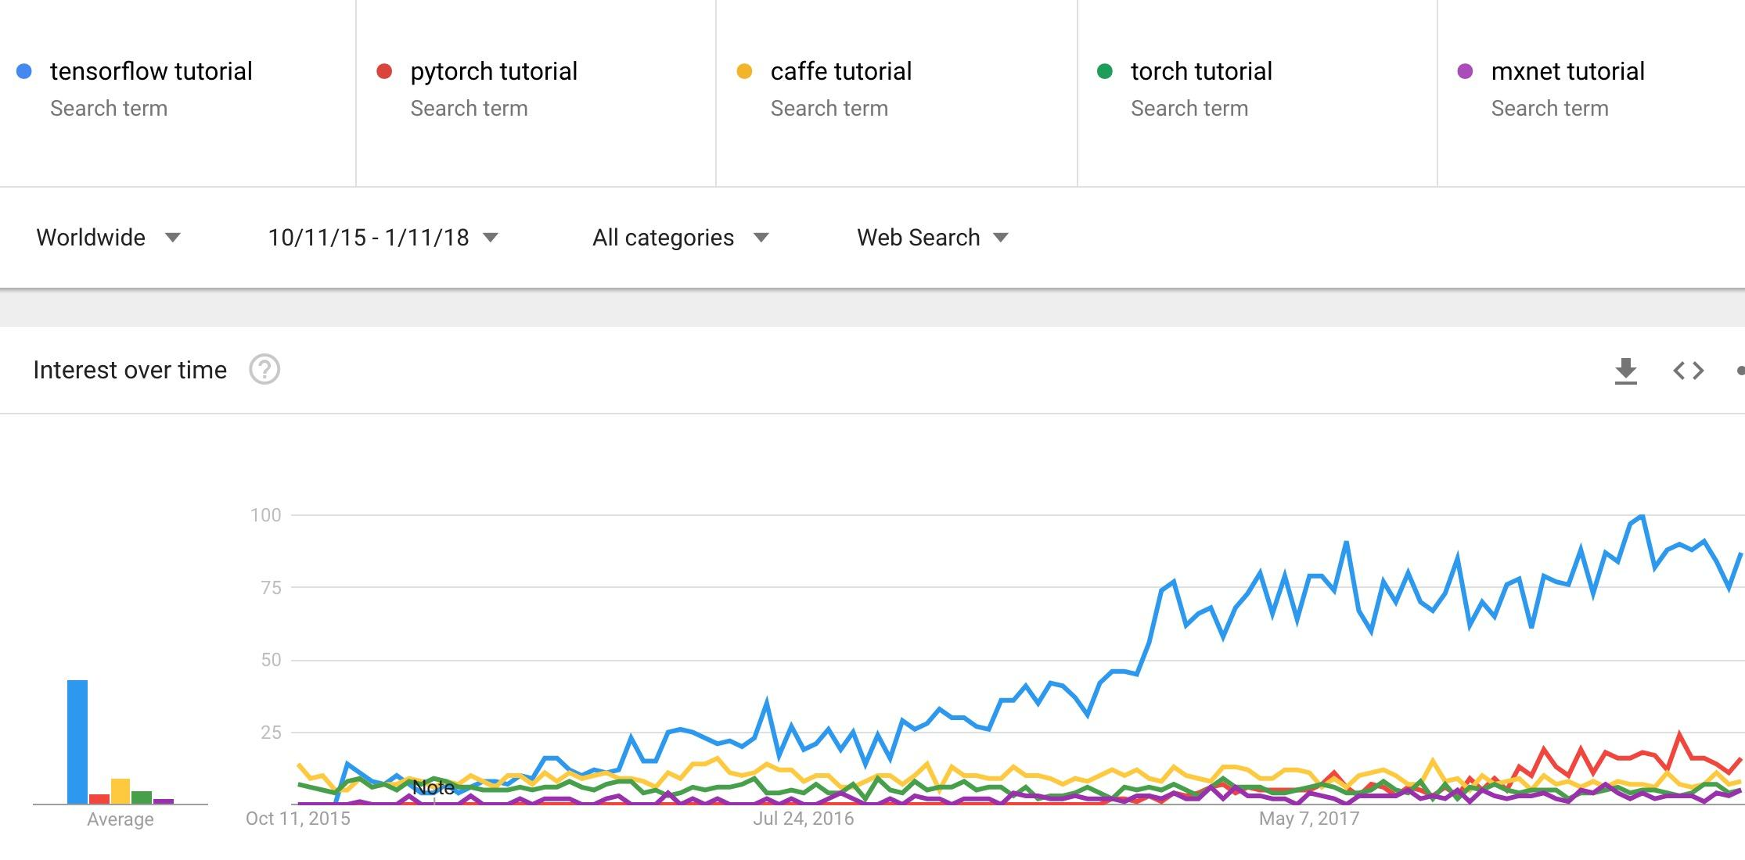
Demand for tutorials on TensorFlow

Slide 11
Some cool projects using TensorFlow

Slide 12
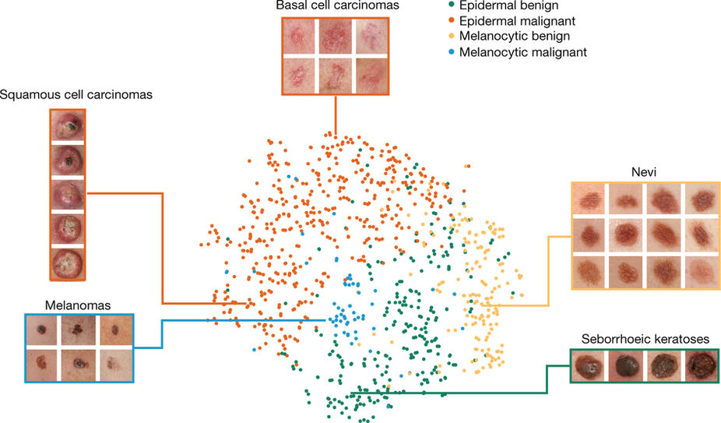
Classify skin cancer
Dermatologist-level classification of skin cancer with deep neural networks (Esteva et al., Nature 2017)

Slide 13
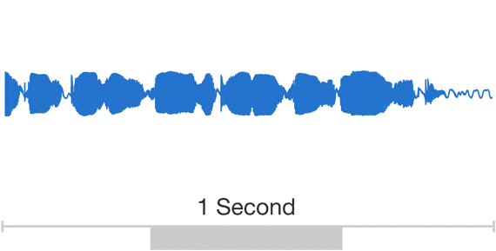
WaveNet: Text to Speech
It takes several hours to synthesize 1 second!
Wavenet: A generative model for raw audio (Oord et al., 2016)
Notes:
a deep generative model of raw audio waveforms.
WaveNets are able to generate speech which mimics any human voice and which sounds more natural than the best existing Text-to-Speech systems, reducing the gap with human performance by over 50%.
https://deepmind.com/blog/wavenet-generative-model-raw-audio/

Slide 14

Drawing
Draw Together with a Neural Network (Ha et al., 2017)
Notes:
https://magenta.tensorflow.org/sketch-rnn-demo

Slide 15
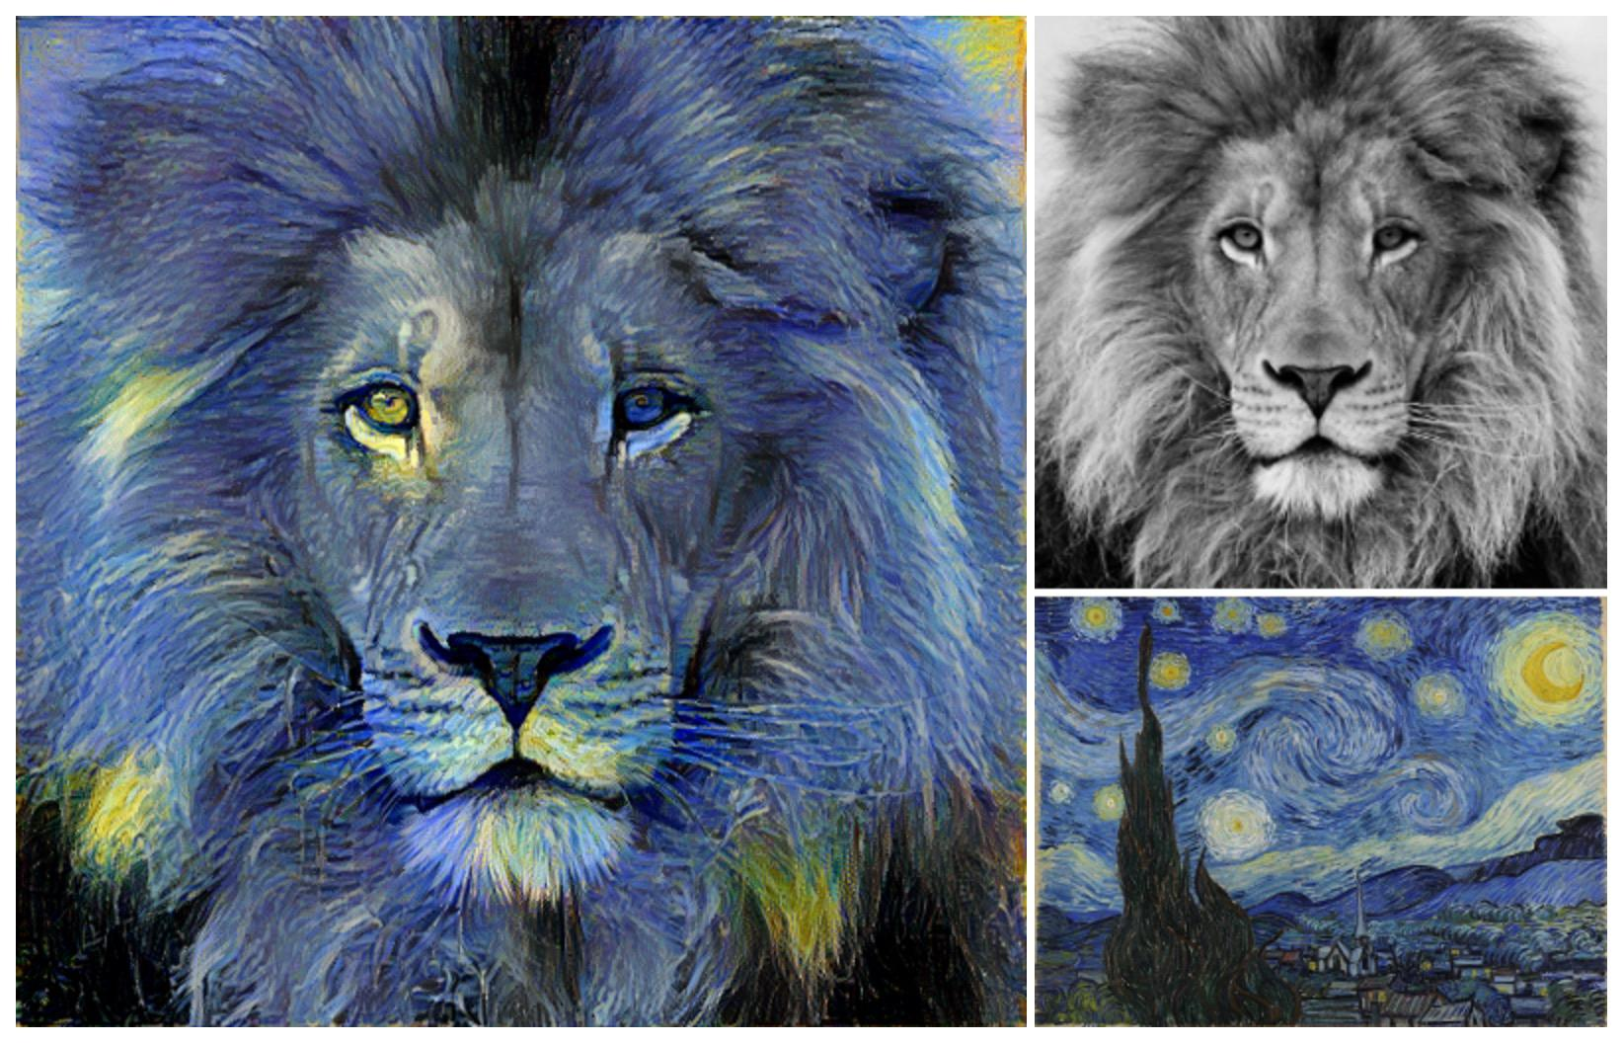
Neural Style Translation
Image Style Transfer Using Convolutional Neural Networks (Gatys et al., 2016)
Tensorflow adaptation by Cameroon Smith (cysmith@github)
Notes:
transferring the artistic style of The Starry Night onto a photograph of an African lion

Slide 16
I hope that this class will give you the tool to build cool projects like those!

Slide 17
Goals
Understand TF’s computation graph approach
Explore TF’s built-in functions and classes
Learn how to build and structure models best suited for a deep learning project

Slide 18
CS20

Slide 19
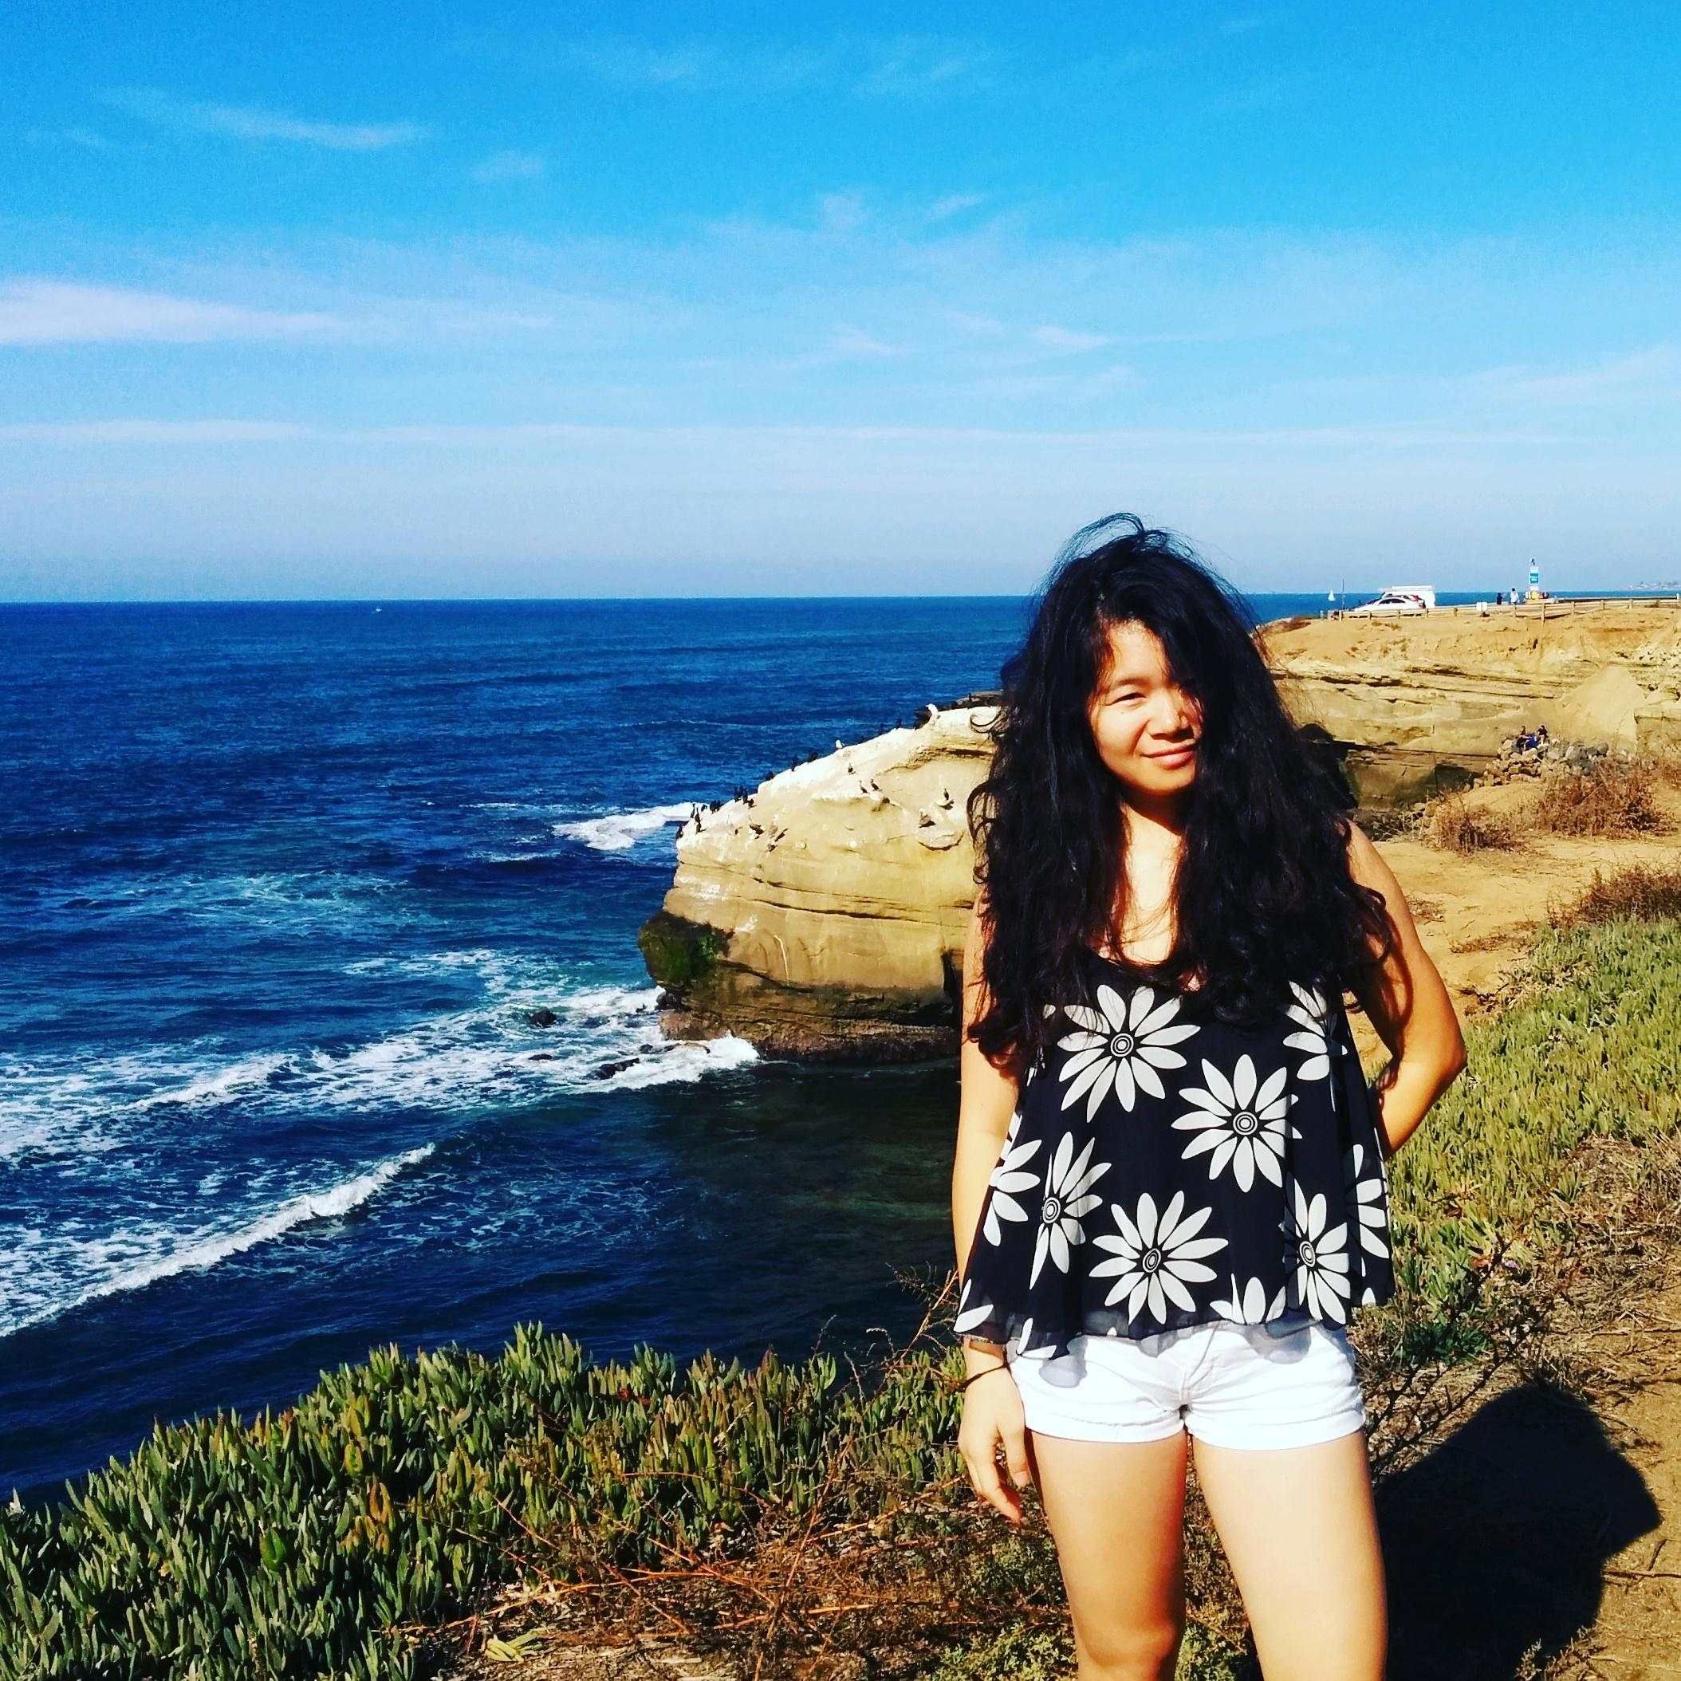

Staff
Chip Huyen huyenn@stanford.edu
Michael Straka mstraka2@stanford.edu
Pedro Garzon pgarzon@stanford.edu

Slide 20
Logistics
Piazza: piazza.com/stanford/winter2018/cs20
Staff email: cs20-win1718-staff@lists.stanford.edu
Students mailing list: cs20-win1718-students
Guests mailing list: cs20-win1718-guests

Slide 21
Grading
Assignments (3)
Participation
Check in

Slide 22
Resources
The official documentations
TensorFlow’s official sample models
StackOverflow should be your first port of call in case of bug
Books
Aurélien Géron’s Hands-On Machine Learning with Scikit-Learn and TensorFlow (O’Reilly, March 2017)
François Chollet’s Deep Learning with Python (Manning Publications, November 2017)
Nishant Shukla’s Machine Learning with TensorFlow (Manning Publications, January 2018)
Lieder et al.’s Learning TensorFlow A Guide to Building Deep Learning Systems (O’Reilly, August 2017)

Slide 23
Permission Number
Link

Slide 24
Many of you are ahead of me in academia so I probably need more of your help than you do mine

Slide 25
Getting Started

Slide 26
import tensorflow as tf

Slide 27
Graphs and Sessions

Slide 28
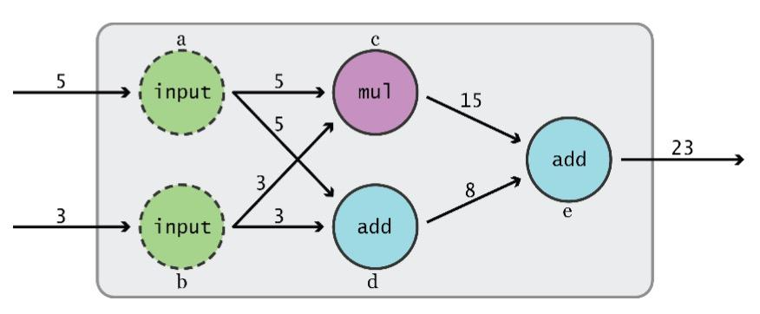
Data Flow Graphs
TensorFlow separates definition of computations from their execution
Graph from TensorFlow for Machine Intelligence
Notes:
How does it do so? By using graphs and sessions

Slide 29
Data Flow Graphs
Phase 1: assemble a graph
Phase 2: use a session to execute operations in the graph.
Graph from TensorFlow for Machine Intelligence

Slide 30
Data Flow Graphs
This might change in the future with eager mode!!
Phase 1: assemble a graph
Phase 2: use a session to execute operations in the graph.
Graph from TensorFlow for Machine Intelligence

Slide 31
What’s a tensor?

Slide 32
What’s a tensor?
An n-dimensional array
0-d tensor: scalar (number)
1-d tensor: vector
2-d tensor: matrix
and so on

Slide 33
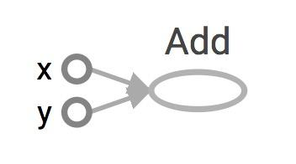
Data Flow Graphs
import tensorflow as tf a = tf.add(3, 5)
Visualized by TensorBoard
Notes:
More about naming them in the next module

Slide 34
Data Flow Graphs
import tensorflow as tf a = tf.add(3, 5)
Visualized by TensorBoard
Why x, y?
TF automatically names the nodes when you don’t explicitly name them.
x = 3
y = 5
Notes:
More about naming them in the next module

Slide 35
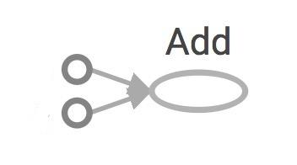
Data Flow Graphs
import tensorflow as tf a = tf.add(3, 5)
Interpreted?
3
Nodes: operators, variables, and constants
Edges: tensors
5
a
Notes:
Different from graphs we might be familiar in which nodes are values, edges are functions

Slide 36
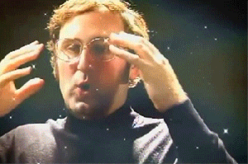
Data Flow Graphs
import tensorflow as tf a = tf.add(3, 5)
Interpreted?
3
Nodes: operators, variables, and constants
Edges: tensors
Tensors are data.
TensorFlow = tensor + flow = data + flow
(I know, mind=blown)
5
a
Notes:
Different from graphs we might be familiar in which nodes are values, edges are functions

Slide 37
Data Flow Graphs
import tensorflow as tf a = tf.add(3, 5) print(a)
3
5
a
>> Tensor("Add:0", shape=(), dtype=int32)
(Not 8)

Slide 38
How to get the value of a?
Create a session, assign it to variable sess so we can call it later
Within the session, evaluate the graph to fetch the value of a

Slide 39
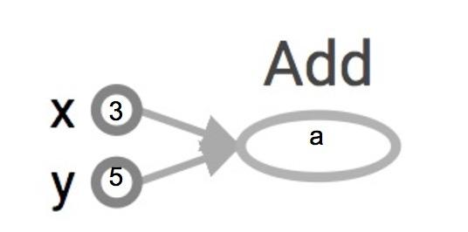
How to get the value of a?
Create a session, assign it to variable sess so we can call it later
Within the session, evaluate the graph to fetch the value of a
import tensorflow as tf a = tf.add(3, 5) sess = tf.Session() print(sess.run(a)) sess.close()
The session will look at the graph, trying to think: hmm, how can I get the value of a,
then it computes all the nodes that leads to a.

Slide 40
How to get the value of a?
Create a session, assign it to variable sess so we can call it later
Within the session, evaluate the graph to fetch the value of a
import tensorflow as tf a = tf.add(3, 5) sess = tf.Session() print(sess.run(a)) sess.close()
>> 8
8
The session will look at the graph, trying to think: hmm, how can I get the value of a,
then it computes all the nodes that leads to a.

Slide 41
How to get the value of a?
Create a session, assign it to variable sess so we can call it later
Within the session, evaluate the graph to fetch the value of a
import tensorflow as tf a = tf.add(3, 5) sess = tf.Session() with tf.Session() as sess: print(sess.run(a)) sess.close()
8

Slide 42
tf.Session()
A Session object encapsulates the environment in which Operation objects are executed, and Tensor objects are evaluated.

Slide 43
tf.Session()
A Session object encapsulates the environment in which Operation objects are executed, and Tensor objects are evaluated.
Session will also allocate memory to store the current values of variables.
Notes:
Note that sessions deal with memory allocation

Slide 44
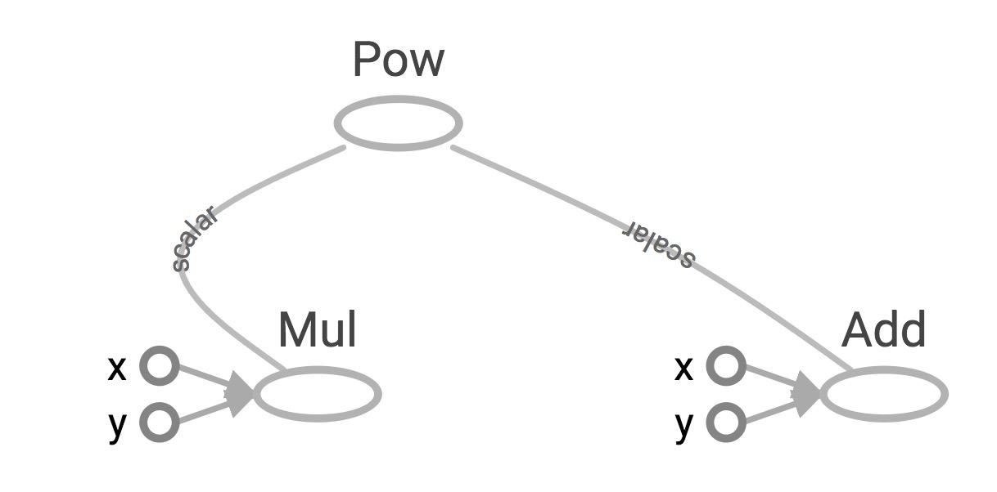
More graph
Visualized by TensorBoard
x = 2 y = 3 op1 = tf.add(x, y) op2 = tf.multiply(x, y) op3 = tf.pow(op2, op1) with tf.Session() as sess: op3 = sess.run(op3)

Slide 45
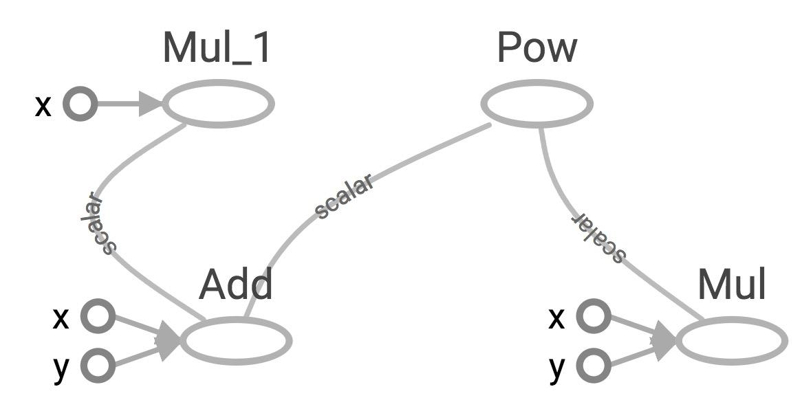
Subgraphs
x = 2 y = 3 add_op = tf.add(x, y) mul_op = tf.multiply(x, y) useless = tf.multiply(x, add_op) pow_op = tf.pow(add_op, mul_op) with tf.Session() as sess: z = sess.run(pow_op)
useless
pow_op
add_op
mul_op
Because we only want the value of pow_op and pow_op doesn’t depend on useless, session won’t compute value of useless
→ save computation

Slide 46
Subgraphs
x = 2 y = 3 add_op = tf.add(x, y) mul_op = tf.multiply(x, y) useless = tf.multiply(x, add_op) pow_op = tf.pow(add_op, mul_op) with tf.Session() as sess: z, not_useless = sess.run([pow_op, useless])
useless
pow_op
add_op
mul_op
tf.Session.run(fetches,
feed_dict=None,
options=None,
run_metadata=None)
fetches is a list of tensors whose values you want

Slide 47
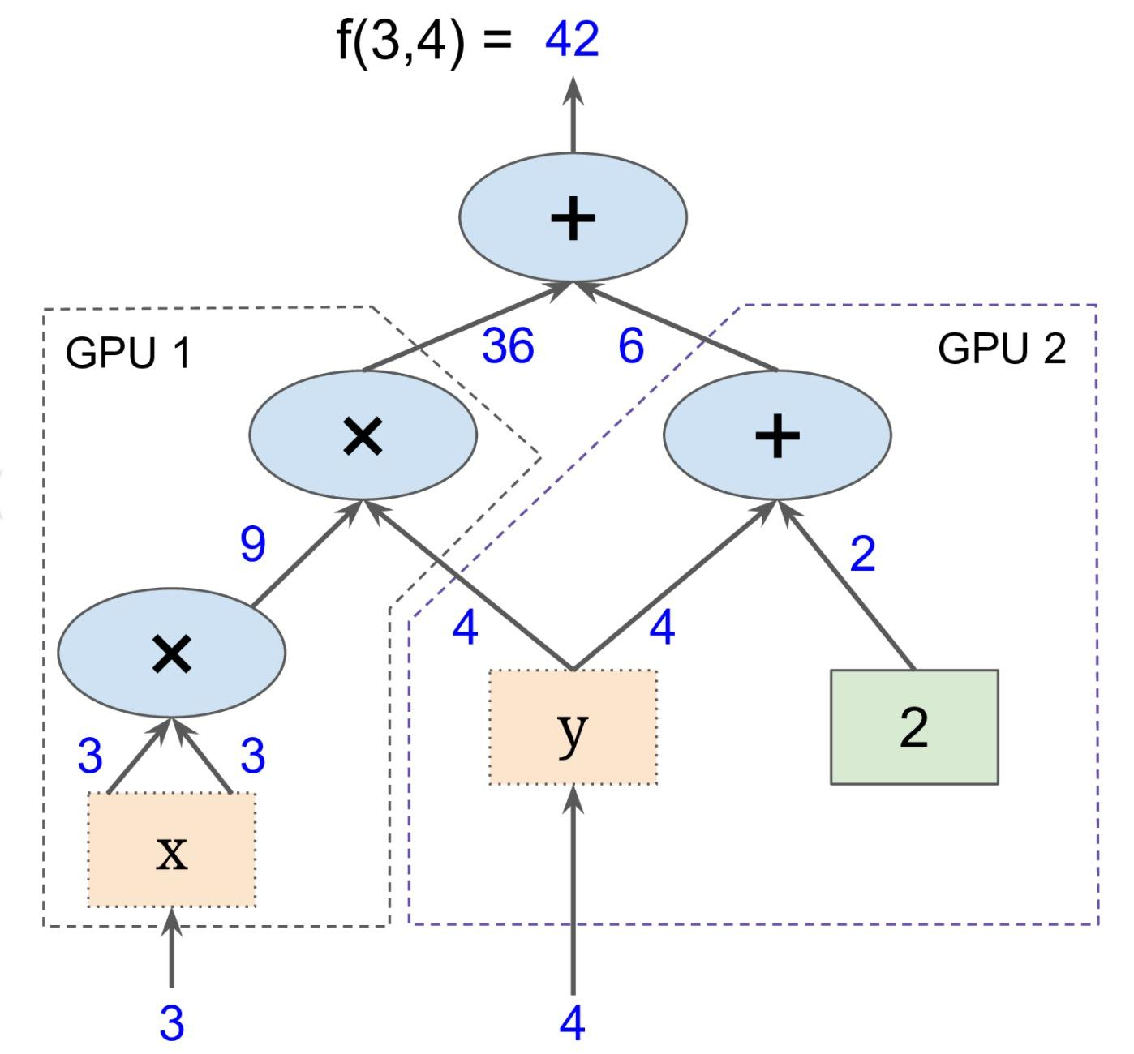
Subgraphs
Possible to break graphs into several chunks and run them parallelly across multiple CPUs, GPUs, TPUs, or other devices
Example: AlexNet
Graph from Hands-On Machine Learning with Scikit-Learn and TensorFlow
Notes:
Example: In the first convolutional layer, AlexNet has 96 filters on two different GPUs. AlexNet is the winner of ImageNet challenge 2012

Slide 48
Distributed Computation
To put part of a graph on a specific CPU or GPU:
# Creates a graph.
with tf.device('/gpu:2'):
a = tf.constant([1.0, 2.0, 3.0, 4.0, 5.0, 6.0], name='a')
b = tf.constant([1.0, 2.0, 3.0, 4.0, 5.0, 6.0], name='b')
c = tf.multiply(a, b)
# Creates a session with log_device_placement set to True.
sess = tf.Session(config=tf.ConfigProto(log_device_placement=True))
# Runs the op.
print(sess.run(c))

Slide 49
What if I want to build more
than one graph?

Slide 50
You can
but you don’t need more than one graph
The session runs the default graph

Slide 51
But what if I really want to?

Slide 52
URGH, NO

Slide 53
BUG ALERT!
Multiple graphs require multiple sessions, each will try to use all available resources by default
Can't pass data between them without passing them through python/numpy, which doesn't work in distributed
It’s better to have disconnected subgraphs within one graph

Slide 54
I insist ...

Slide 55
tf.Graph()
create a graph:
g = tf.Graph()

Slide 56
tf.Graph()
to add operators to a graph, set it as default:
g = tf.Graph() with g.as_default(): x = tf.add(3, 5) sess = tf.Session(graph=g) with tf.Session() as sess: sess.run(x)

Slide 57
tf.Graph()
To handle the default graph:
g = tf.get_default_graph()

Slide 58
tf.Graph()
Do not mix default graph and user created graphs
g = tf.Graph()
# add ops to the default graph a = tf.constant(3)
# add ops to the user created graph with g.as_default(): b = tf.constant(5)
Prone to errors

Slide 59
tf.Graph()
Do not mix default graph and user created graphs
g1 = tf.get_default_graph() g2 = tf.Graph()
# add ops to the default graph with g1.as_default(): a = tf.Constant(3)
# add ops to the user created graph with g2.as_default(): b = tf.Constant(5)
Better
But still not good enough because no more than one graph!

Slide 60

Notes:
Why graphs?

Slide 61
Why graphs
Save computation. Only run subgraphs that lead to the values you want to fetch.

Slide 62
Why graphs
Save computation. Only run subgraphs that lead to the values you want to fetch.
Break computation into small, differential pieces to facilitate auto-differentiation

Slide 63
Why graphs
Save computation. Only run subgraphs that lead to the values you want to fetch.
Break computation into small, differential pieces to facilitate auto-differentiation
Facilitate distributed computation, spread the work across multiple CPUs, GPUs, TPUs, or other devices

Slide 64
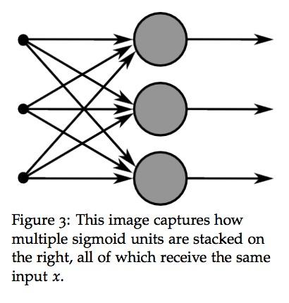
Why graphs
Save computation. Only run subgraphs that lead to the values you want to fetch.
Break computation into small, differential pieces to facilitate auto-differentiation
Facilitate distributed computation, spread the work across multiple CPUs, GPUs, TPUs, or other devices
Many common machine learning models are taught and visualized as directed graphs
A neural net graph from Stanford’s CS224N course
Notes:
Many common machine learning models, such as neural networks, are commonly taught and visualized as directed graphs already, which makes their implementation more natural for machine learning practitioners.
By splitting up computation into small, easily differentiable pieces, TF is able to automatically compute the derivative of any node (or “Operation”, as they’re called in TensorFlow) with respect to any other node that can affect the first node’s output. Being able to compute the derivative/gradient of nodes, especially output nodes, is crucial for setting up machine learning models.
Third having the computation separated, it makes it much easier to distribute work across multiple CPUs, GPUs, and other computational devices. Simply split the whole, larger graph into several smaller graphs and give each device a separate part of the graph to work on (with a touch of logic to coordinate sharing information across devices)

Slide 65
Next class
Basic operations
Constants and variables
Data pipeline
Fun with TensorBoard
Feedback: huyenn@stanford.edu
Thanks!

